Slide 1
Article Summarization and Categorization
By
Ayyappa Ankishetty
Jaya Prakash Reddy Gade
Divya Geethanjali Birudharaju

Slide 2
Contents
Motivation, Significance, Objectives
Text Summarization
Text Categorization
Features
Text Summarization Models
Text Categorization Models
Outputs
User Interface

Slide 3
Motivation, Significance, Objectives
Motivation :
The motivation behind this project is, we find few articles on Instagram (captions of post), Blog or any social platform but it would be difficult for us to find what is in the article before reading it. Sometimes, after seeing the length of the article, we might lose interest and stop reading it.
Significance :
Summarization helps individuals to ignore unimportant information in the text.
Categorization helps people to identify what is the article about.
Summarization and Categorization both can help lot of people, especially students to read the articles which are related to the topic they want to learn about.
Objectives :
To create a model which summarizes and categorize articles.
Train the model with the existing data of article summarization and categorization
To achieve a model with a good accuracy.
To create a user-friendly UI which is connected to the backend.

Slide 4
Text Summarization
For text summarization, we are using extractive summarization using cosine similarity technique.
Extractive summarization extracts information from the original text that is identical to the original content. In other words, rather than producing a unique summary based on the entire document, it will rank each sentence in the document against all of the others based on the sentence's explanatory power.
Text Categorization
Classifying the category of Article.

Slide 5
Features
Links Deletion
Fixing Word Length
Remove Unwanted Symbols and Stopwords
Stemming
Lower Case

Slide 6
Text Summarization Models
TextRank
Gensim
NLTK summarizer

Slide 7
Text Categorization Models
Decision Tree
Random Forest
KNN
Ridge Classifier
Gaussian Naïve Bayes
Logistic Regression
Keras Tokenizer

Slide 8
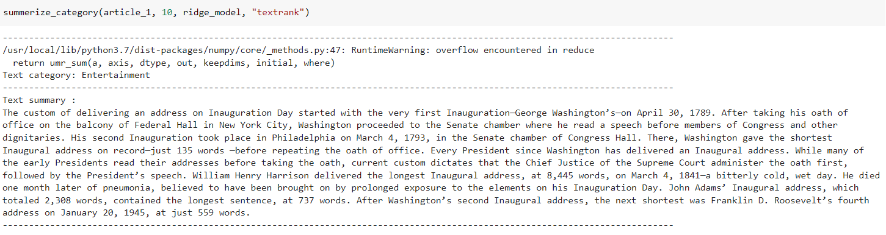
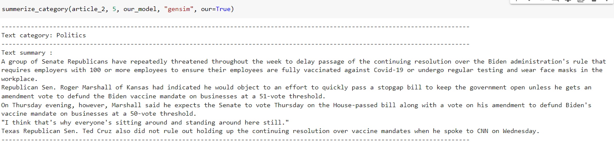
Outputs

Slide 9
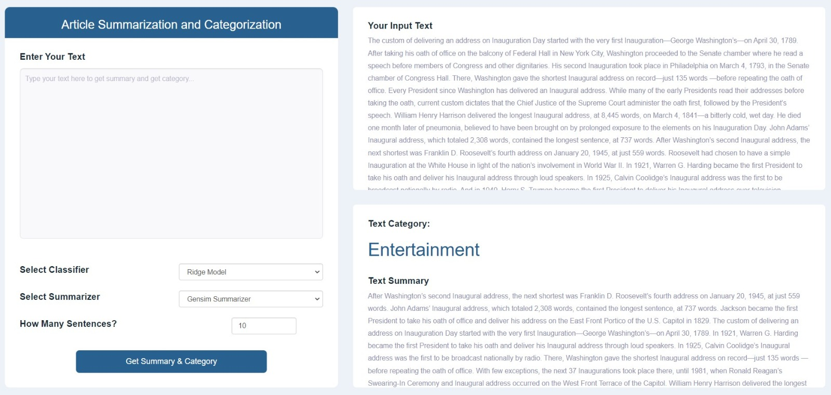
UI Outputs

Slide 10
Thank You!!!!

